Slide 1

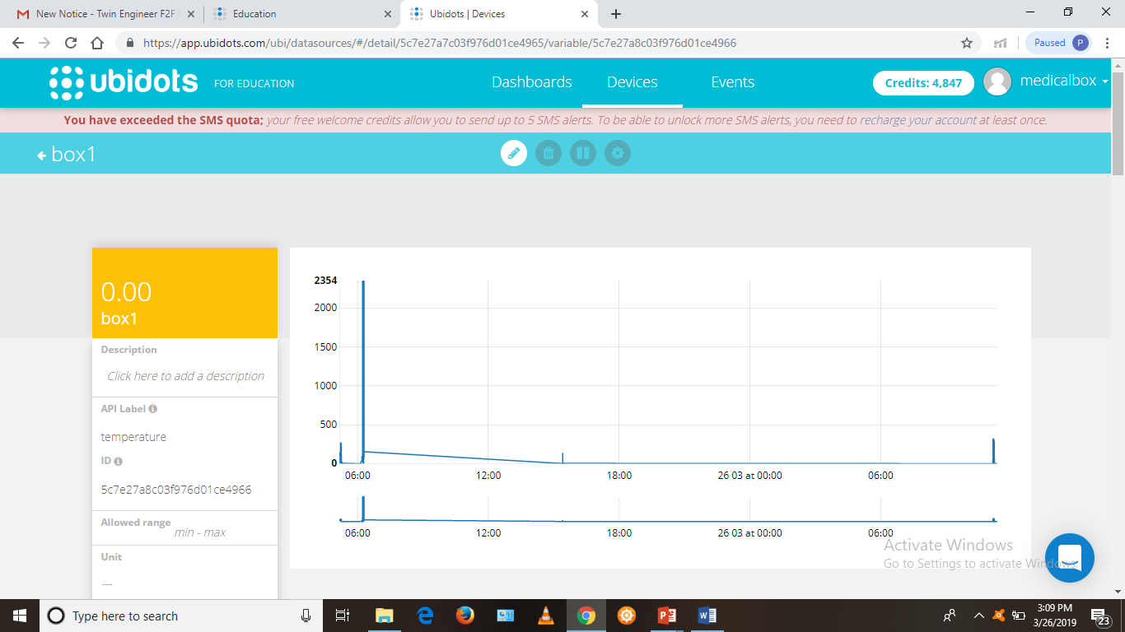
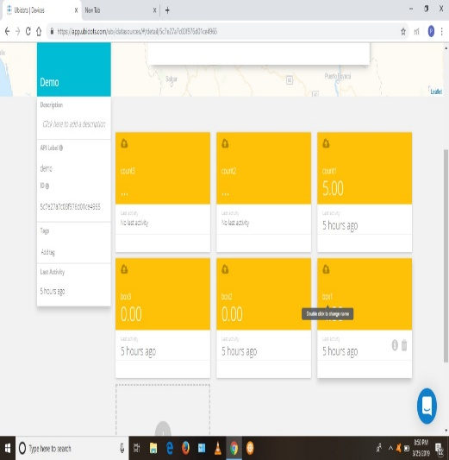
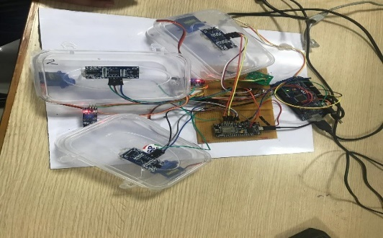
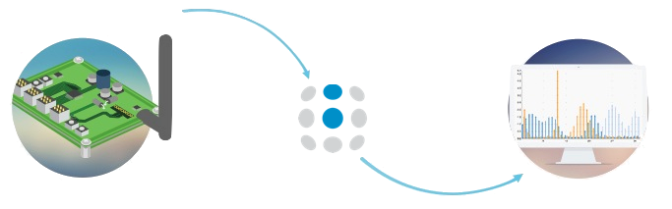
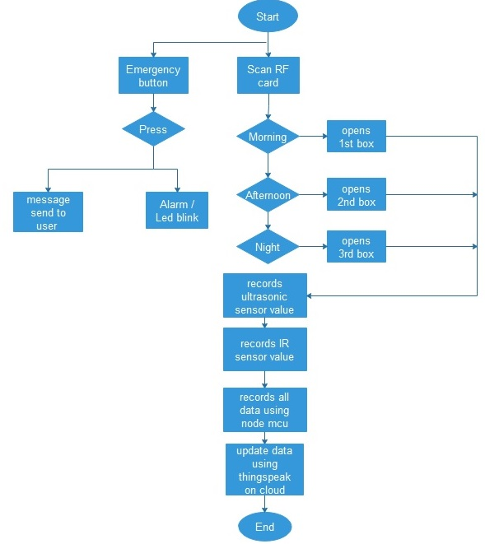
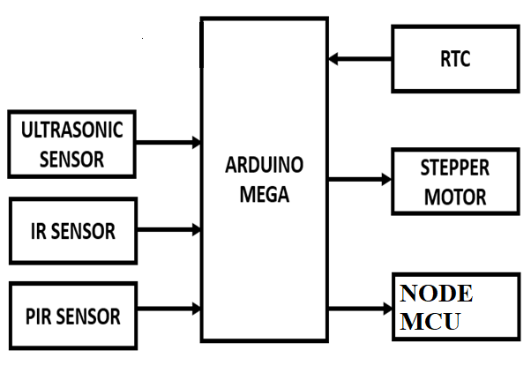

SMART IoT ENABLED INTELLIGENT – HEALTH MEDICINE DEVICE
ARPANA ARLAND (RA1511004010706), SUSHANT KUMAR(RA1511004010713), NITIN ASTHANA(RA1511004010717),
PRATEEK SRIVASTAVA(RA1511004010721) Guide Name:-Mrs.V. Padmajothi Assistant Professor (Sr.G)
MOTIVE
EXPERIMENTAL RESULTS
REALISTIC CONSTRAINTS
To maintain the schedule of taking medicine.
Helpful for old persons who have weak memory.
Helpful for nurses who get confused in giving medicine to her number of patient.
It maintains the regularity of taking medicine and due to this patient can complete course of medicine easily.
Single device can handle number of patient that is why it is cheap and best.
Majority of the people may it be elderly or middle age person found it to be useful
Patient were able to maintain consistency of medication without fail
With the help of proper medication at proper time, people recovered soon
Elderly people found it to be friendly for use
Since the ultrasonic sensor on opening the box measures inaccurate reading because of its position, we're trying to correct it's reading in coding simulation such that it takes reading only when the box is closed.
It is assumed that whenever a hand is placed inside the box, only 1 pill has been taken out for sure.
Lifespan of sensors is less and hence may require replacement
In case, wrong timing is updated in code, it will indicate to take medication at wrong time.
It needs constant power supply to work
SYSTEM MODEL BASIC
MULTIDISCIPLINARY TASKS
IoT is short for Internet of Things. The Internet of Things refers to the ever-growing network of physical objects that feature an IP address for internet connectivity, and the communication that occurs between these objects and other Internet-enabled devices and systems.
Electronics and Communication Engineering for IoT and Node-McU.
Electrical Engineering for wires and Arduino Mega..
Instrumentation and Control Engineering for Ultrasonic and IR sensor.
Mechanical Engineering for servo motors.
Desktop publication for report..
METHODOLOGY
Planning
Design and development
Simulation
Testing
Troubleshooting errors and debugging
CONCLUSION
Older people experience several practical problems using their medicines, and their strategies to manage these problems are sometimes suboptimal.
These problems can lead to incorrect medication use with clinically relevant consequences.
The findings pose a challenge for healthcare professionals, drug developers, and regulators to diminish these problems.
The correct and timely use of medication determines its therapeutic effect, yet several steps are involved in taking medicines as recommended, such as reading and understanding the user information, opening and removing the medicine from the outer and inner packaging, any preparation before use, and taking the medicine.
This project aimed to resolve the practical problems that older people experience with the daily use of their medicines and their management strategies to address these problems and to determine the potential clinical relevance thereof.
SOFTWARE USED
Ubidots: IoT platform | Internet of Things
Connect, Develop, and Deploy IoT Applications with Ubidots Intuative IoT Development Platform
Arduino c
FUTURE WORK
FLOWCHART / BLOCK DIAGRAM
In the future, we hope that this smart medicine box can be to linked to the online med karts, if in case the tablets are empty it directly sends a prescription message to the med kart in which they can help us delivering the prescribed tablets to our door step.
We can also try connecting our smart phones and smart devices to the medicine box so it can keep a track of the patient's routine like his daily movement, heartbeat, blood pressure etc.
REFERENCES
An IoT-Aware Architecture for Smart Healthcare Systems. Luca Catarinucci, Danilo De Donno, Luca Mainetti ,IEEE Internet of Things Journal, November 2015.
A Health-IoT Platform Based on the Integration of Intelligent Packaging, Unobtrusive Bio-Sensor and Intelligent Medicine Box. Geng Yang, Li Xie, Matti Mäntysalo, Xiaolin Zhou, IEEE Transactions on Industrial Informatics, November 2014.
An Electronic Pillbox for Continuous Monitoring of Medication Adherence, Tamara. L. Hayes John, M. Hunt, Andre Adami, and Jeffrey A. Kaye, IEEE Engineering in Medicine and Biology Society, October 2012.
Reconfigurable Smart Factory for Drug Packing in Healthcare Industry 4.0. Jiafu Wan, Shenglong Tang, Di Li, Muhammad Imran, Chunhua Zhang, Chengliang Liu, Zhibo Pang, IEEE Transactions on Industrial Informatics Oct 2018.
STANDARDS USED
IEEE 802.11
RS232-Serial Communication

